Slide 1
Time Series Project Texas COVID-19 Case Prediction
Cameron Stewart & Ana Elsa Glaser

Slide 2
Agenda
Project Overview
Data Description
Explore Variables
Compare Models
ARIMA
VAR
MLP
Ensemble
Conclusion and Next Steps
Appendix
GitHub Repository
Test Questions
Presentation Video Link

Slide 3

Project Overview
Stakeholders
Texas Government Policy Makers
Objective
Forecast Texas COVID-19 Case Count
Short Term Forecast 7-Days ahead
Long Term Forecast 21-Days ahead
Purpose
Understand state of pandemic so policy makers can make informed policy decisions

Slide 4
Data Description
COVID-19 Case Data
Source: Texas Department of State Health Services
Date Range: March 2020 – present
https://www.arcgis.com/apps/dashboards/45e18cba105c478697c76acbbf86a6bc
Vaccination Doses Administered
Texas Department of State Health Services
Date Range: December 2020 – present
https://www.arcgis.com/apps/dashboards/45e18cba105c478697c76acbbf86a6bc
COVID Test Data
Source: Texas Department of State Health Services
Date Range: September 2020 – present
https://www.arcgis.com/apps/dashboards/45e18cba105c478697c76acbbf86a6bc
Google Mobility Data
Google
Date Range: February 2020 – present
https://www.google.com/covid19/mobility/

Slide 5
Explore Variables

Slide 6
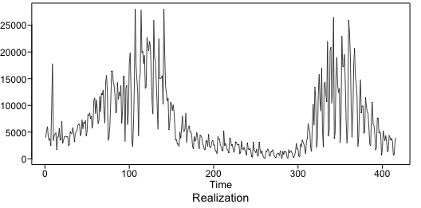
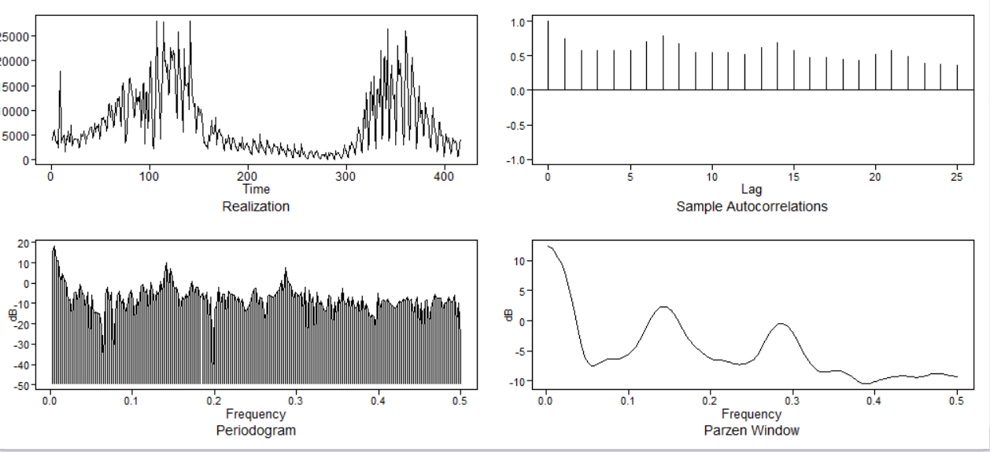
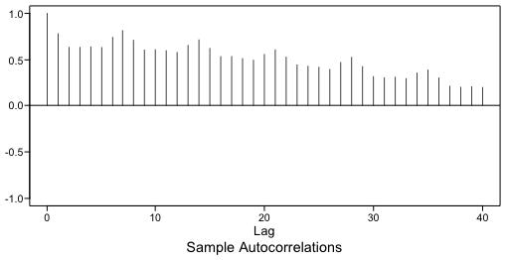
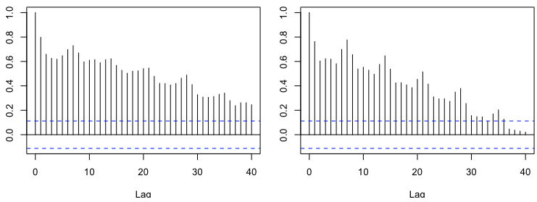
Texas COVID Case Data
First and Second Half ACFs

Slide 7
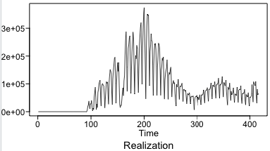
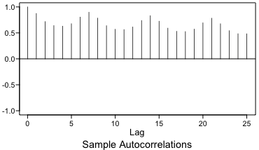
Texas COVID Vaccine Counts
Daily COVID Vaccination Doses Administered
September 2020 – Present shown

Slide 8
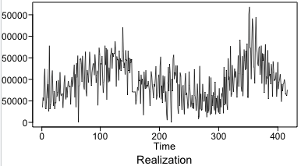
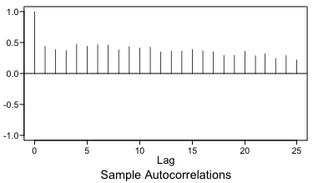
Texas Covid Test Counts
Daily Texas COVID Tests Taken
September 2020 – Present shown

Slide 9
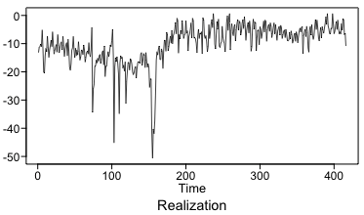
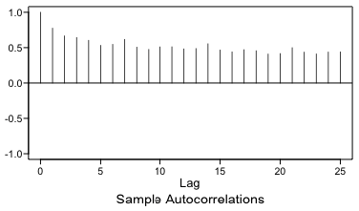
Google Mobility Data
Mobility Data Categories Collected
Retail and Recreation
Grocery and Pharmacy
Parks
Transit Stations
Workplaces
Residential
Mean Mobility Plotted
September 2020 – Present shown

Slide 10
ARIMA Models

Slide 11
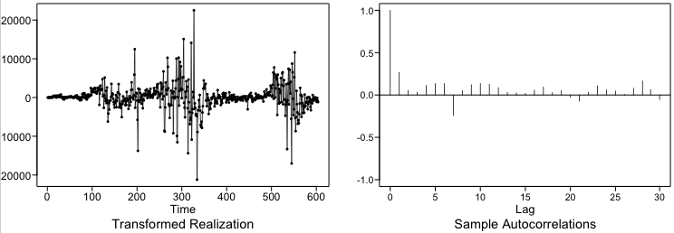
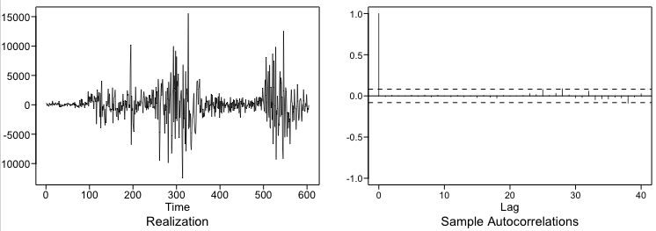
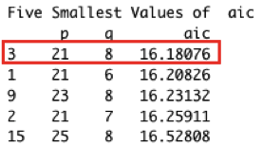
Model 1 - Seasonal Model
Remove Seasonality of 7 Days

Slide 12
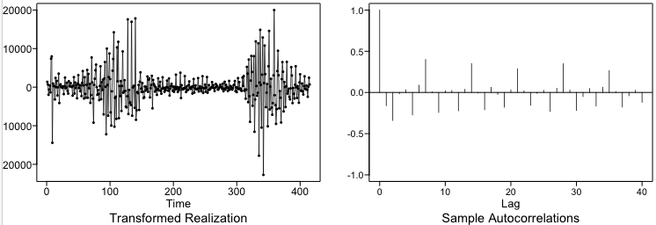
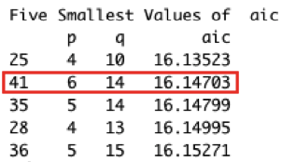
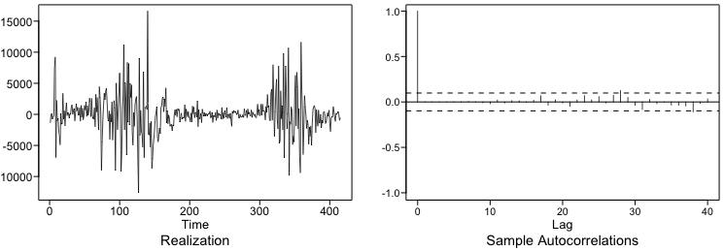
Model 2 - Differencing Model
Remove (1-B) term

Slide 13
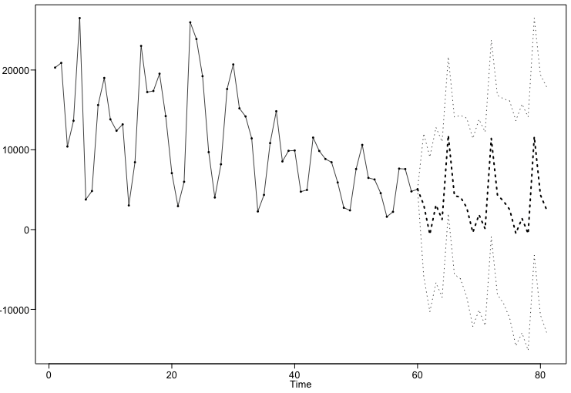
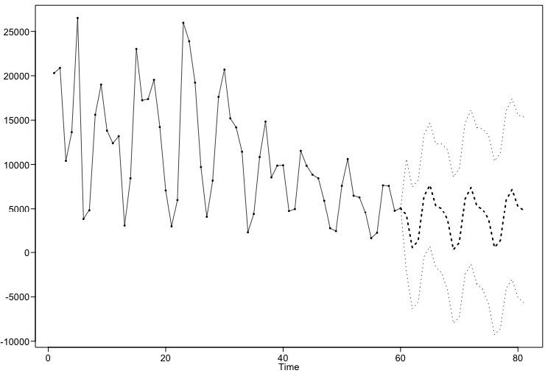
Rolling Window RMSE Comparison
ARIMA(21,0,8) with s = 7
ARIMA(6,1,14)
Rolling Window RMSE:
Short Term Forecast – 7 Days
3457 Cases
Long Term Forecast – 21 Days
4271 Cases
Rolling Window RMSE:
Short Term Forecast – 7 Days
2981 Cases
Long Term Forecast – 21 Days
3806 Cases
RMSE LOWER

Slide 14
Vector autoregression (VAR) Models

Slide 15
VAR Models to be Compared
Model 1 - Fully Differenced
Includes all variables differenced (d=1)
With a constant term
Model 2 – Seasonal and Differenced Response
Differenced Case Data (d=1) and all other variables untransformed
With a constant term and 7 day seasonality
Note: Our team explored many other models which can be found in our RMD file in provided GitHub Repository and the two models included were found to be the most useful

Slide 16
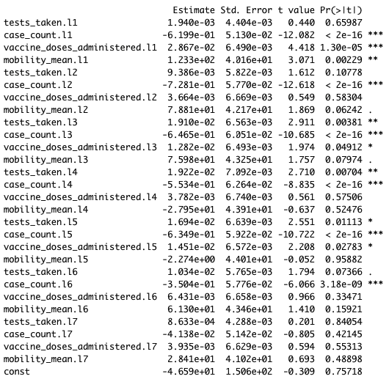
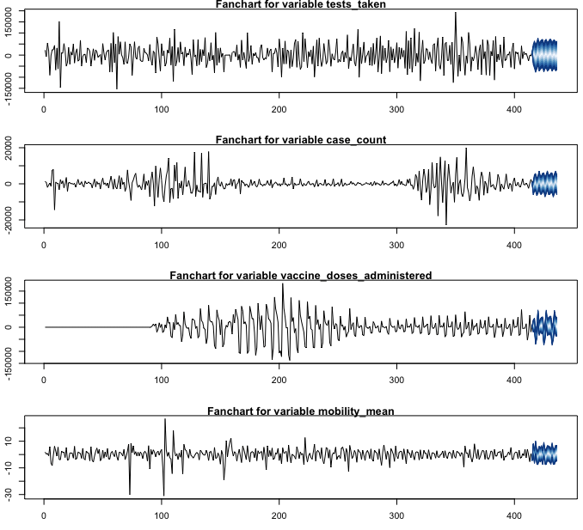
Model 1 - Fully Differenced
VAR Select
Lag 7 had the lowest AIC and BIC

Slide 17
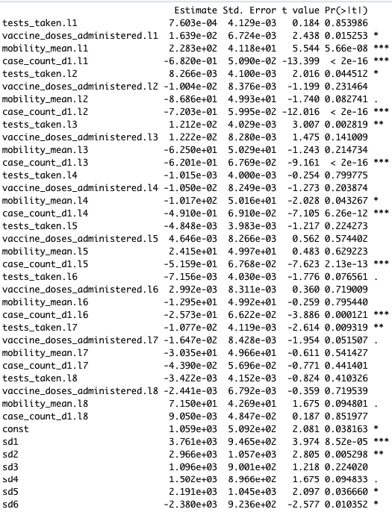
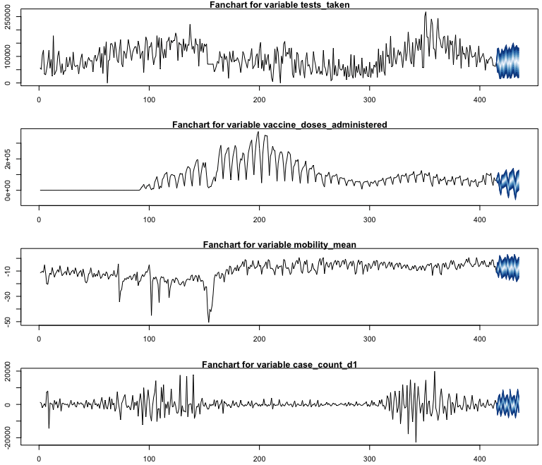
Model 2 – Seasonal and Differenced Response
VAR Select
Lag 8 had the lowest AIC and BIC

Slide 18
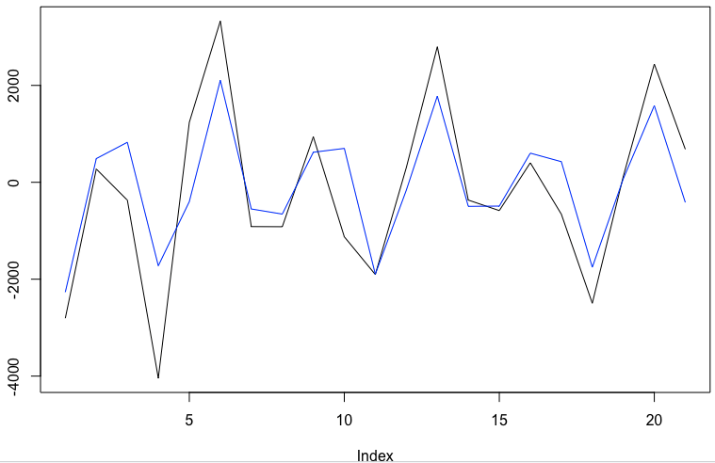
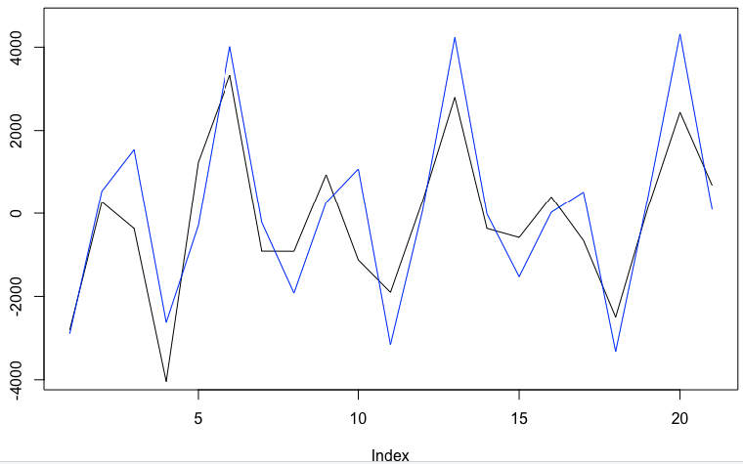
RMSE Comparison
Model 1 – VAR(7)
Model 2 – VAR(8)
Rolling Window RMSE:
Short Term Forecast – 7 Days
1279 Cases
Long Term Forecast – 21 Days
974 Cases
Rolling Window RMSE:
Short Term Forecast – 7 Days
1136 Cases
Long Term Forecast – 21 Days
1117 Cases
Long Term RMSE Lower
Short Term RMSE Lower

Slide 19
Multi-Layer Perceptron (MLP) Models

Slide 20
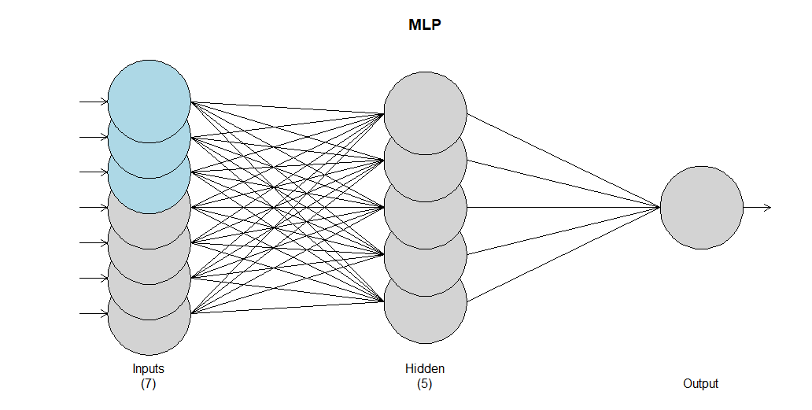
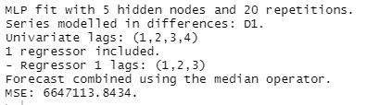
MLP Model 1
First MLP Model → Predict COVID cases based only on test and vaccine data

Slide 21
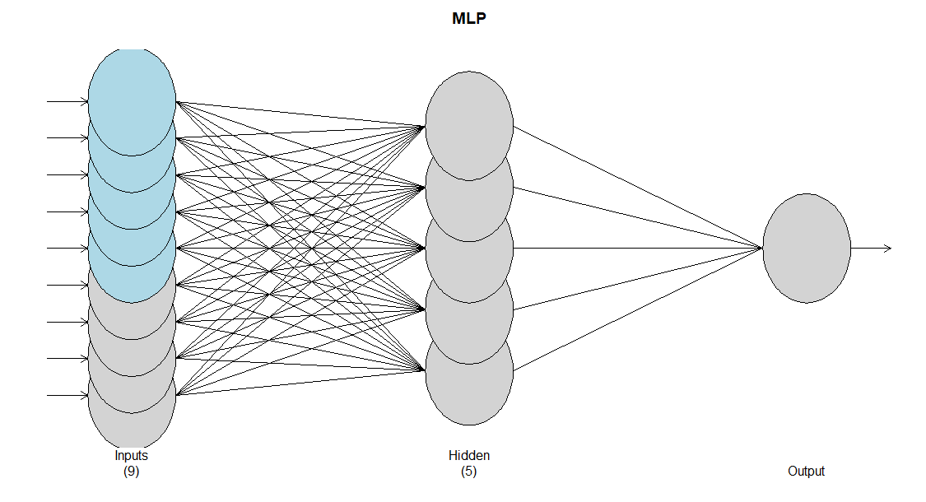
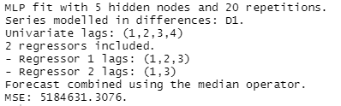
MLP Model 2
Second MLP Model → Predict COVID cases based on tests, vaccines and park mobility data

Slide 22
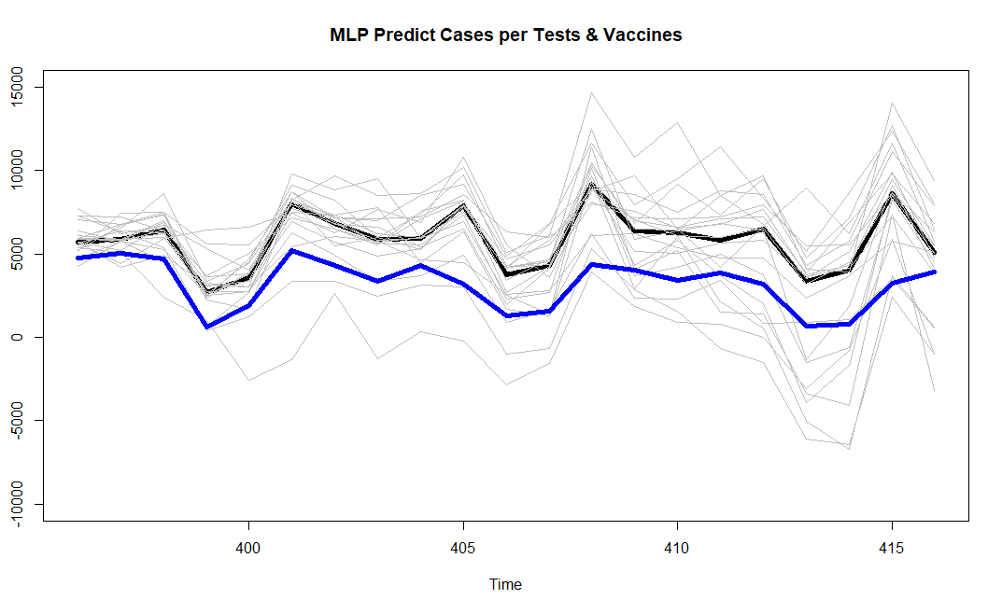
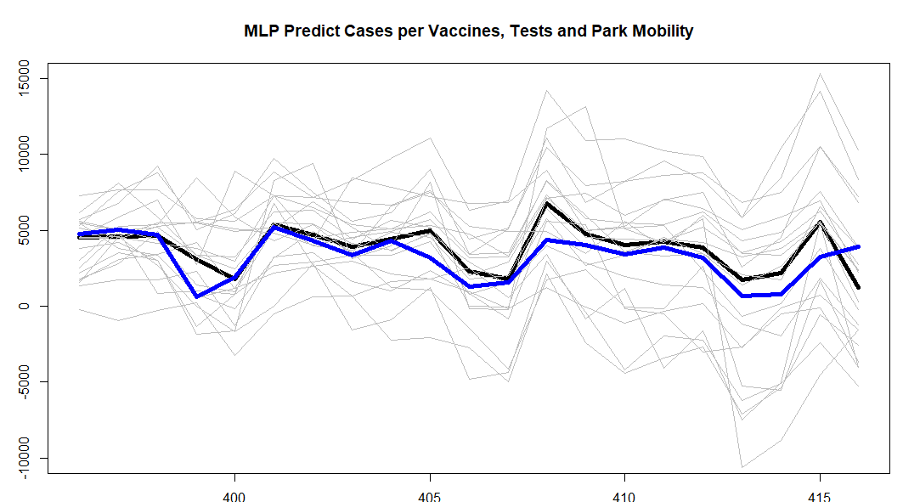
MLP Model Comparison
Forecast RMSE: Vaccines & Tests
Short Term Forecast – 7 Days
1329Cases
Long Term Forecast – 21 Days
2837 Cases
Forecast RMSE: Vaccines, Tests & Mobility
Short Term Forecast – 7 Days
952 Cases
Long Term Forecast – 21 Days
1260 Cases
RMSE LOWER

Slide 23
Ensemble Models

Slide 24
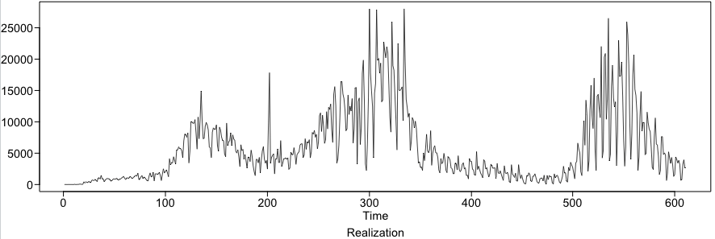
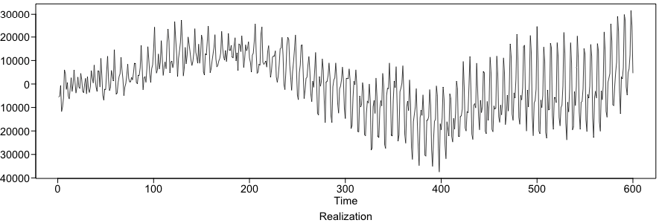
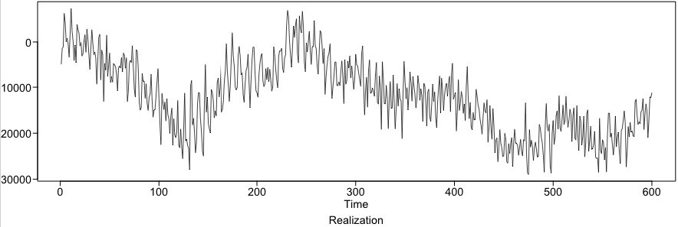
Compare Randomly Generated Plots
Original Realization
ARIMA(21,0,8)
with s = 7
ARIMA(6,1,14)

Slide 25
Conclusion and Next Steps
Selected Model – The ensemble model (VAR + Deep Learning) outperformed the independent VAR and the Deep Learning models
Implementation – Model can be published as a public service dashboard
Next steps – This model could be considered to predict capacity requirements to plan for hospitalizations and available ICU beds

Slide 26
Strategy for rest of analysis
Investigate how to deal with periods of high realization variability
Moving Average Smoothing
Ensemble Modeling
Explore models with regressors such as:
Google Mobility Data
Vaccination Doses
Covid Tests Taken
Develop forecasts with models such as:
Vector AR Models
Neural Network Models

Slide 27
THANK YOU!

Slide 28
Test Question 1
Q: What are the drawbacks in using a single RMSE score vs a Rolling Window to compare forecast models?
A: The RMSE is based on a single realization and the Rolling Window score will evaluate the effectiveness of the model across time

Slide 29
Youtube Link: https://youtu.be/jST1Y_r0Z64
Test Question 2:
Why might it be an issue to use a leading variable to forecast a response in multivariate time series modeling?
Leading variables provide misleading information
Leading variable means your most significant variable and doesn’t provide the complete picture
Leading variables need to be collected before the forecast can be made
Leading variables often don’t account for serial correlation

